Slide 1
OSHA's New System for Managing Chemicals to Achieve Safer, Healthier Workplaces ….. and Beyond
Substitution
and
Elimination
Charlotte Brody, Associate Director for Health Initiatives
BlueGreen Alliance

Slide 2
Why chemicals matter: We’re getting sicker and chemicals are part of the reason why?
Substitution
and
Elimination

Slide 3
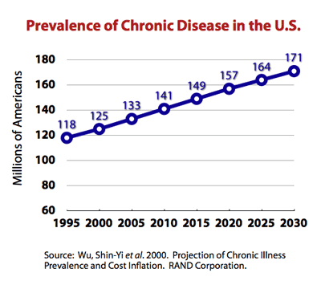
Notes:
Asthma, cancer, heart disease, diabetes, strokes, arthritis
In 2005, 133 million Americans – almost 1 out of every 2 adults – had at least one chronic illness

Slide 4
Cancer Incidence and Mortality in Children
More children are getting cancer but fewer children are dying from cancer

Slide 5
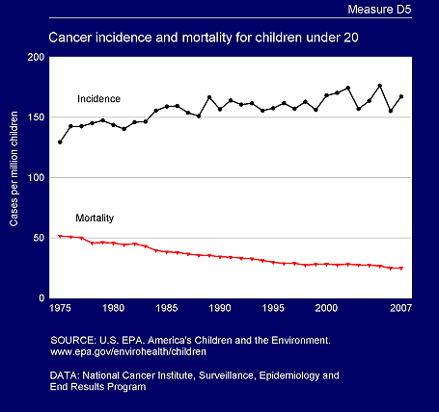
Asthma up 100% Impaired fertility up 40%
Breast Cancer up 40% Autism diagnosis up 1000%
30% more babies are being born too early

Slide 6
The dose makes the poison
Notes:
1493-1541

Slide 7
Why do we think this has anything to do with chemicals? Because wildlife is getting sick too

Slide 8
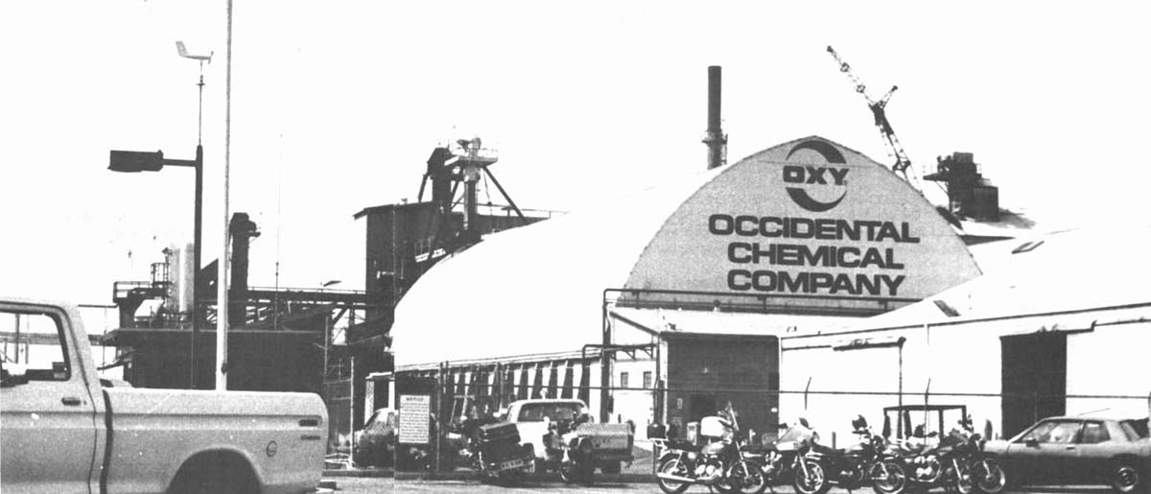
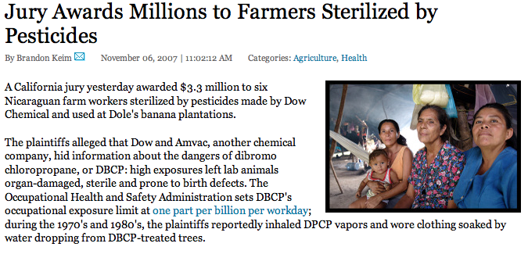
DBCP: Infertility
In the California workers who produced it and the Nicaraguan farmworkers who used it
Notes:
Dibromochloropropane In 1977 Lathrop, California pesticide manufacturing plant workers sub or infertile. Wives had higher rate of miscarriage and had more female infants than normal. Twenty years later, Nicaraguan farm workers who applied the pesticide were compensated for being made sterile by the chemical

Slide 9
Agent Orange: What We Learned From an Uncontrolled Experiment on American Soldiers and the People of Southeast Asia

Slide 10
Hodgkin’s Disease, non Hodgkin’s lymphoma, Prostate Cancer, Chronic B-cell Leukemia, Respiratory Cancers, Type 2 Diabetes, Ischemic Heart Disease, Parkinson’s Disease

Slide 11
Breast Cancer and DDT

Slide 12
Why Timing Can Matter More than Dose

Slide 13
Biomonitoring: Measuring Chemicals in People

Slide 14
CDC reports that Bisphenol A (BPA)
is in more than 90% of the American people
and Perchlorate
is in all of us

Slide 15
From the CDC’s 2009 Fourth National Report on Human Exposure to Environmental Chemicals

Slide 16
I didn’t know that the dose is only one part of the problem: there are also low dose effects, mixtures, synergies, timing, sensitivities and long delays between exposure and visible effects including multigenerational effects.
Notes:
http://www.istas.net/risctox/en/dn_risctox_ficha_sustancia.asp?id_sustancia=958773

Slide 17
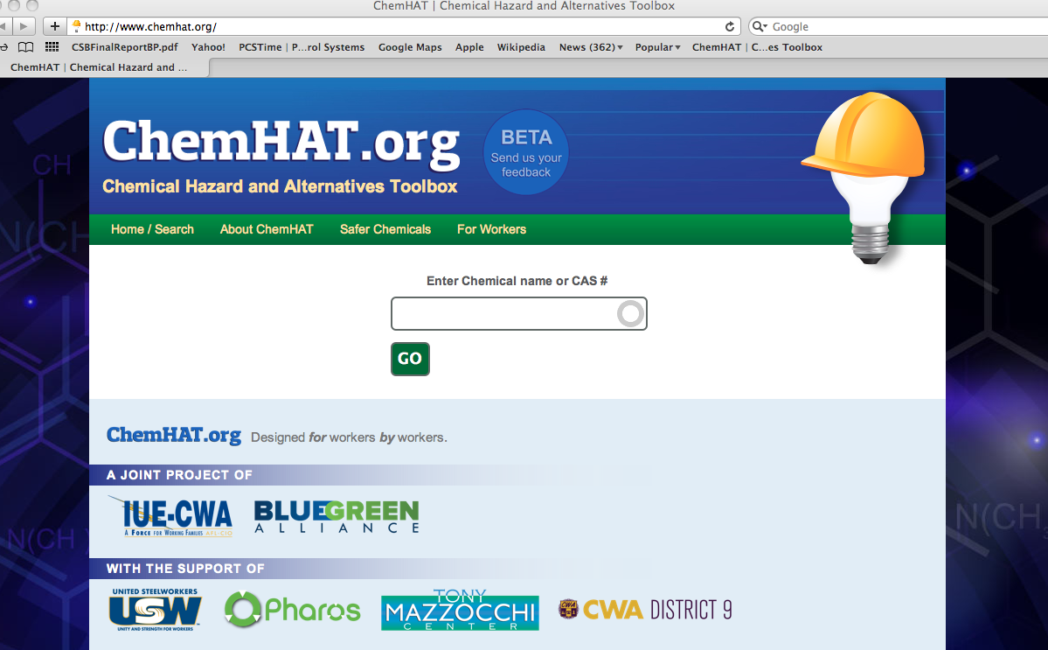
ChemHAT
How it Got Here: How do workers find chemical information?

Slide 18
Ethylene Oxide

Slide 19
Notes:
Is a carcinogen and is also linked to spontaneous abortion and genetic damage

Slide 20
http://hazmap.nlm.nih.gov/cgi-bin/hazmap_generic?tbl=TblAgents&id=21

Slide 21
http://toxtown.nlm.nih.gov/text_version/chemicals.php?id=71

Slide 22
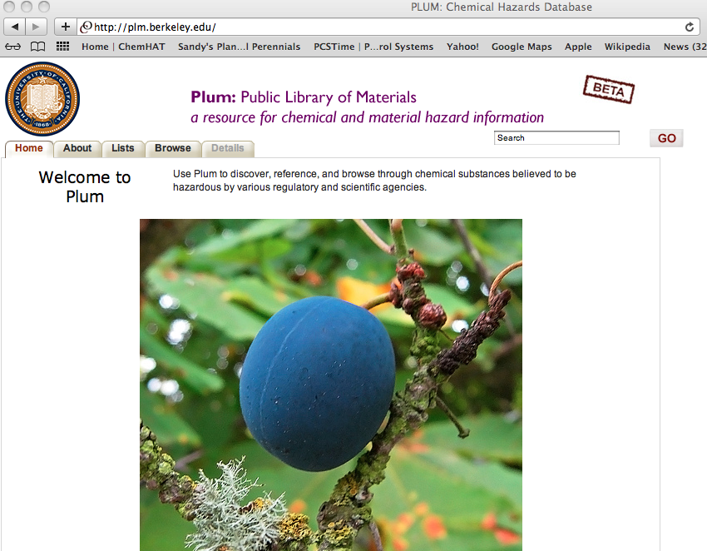

Slide 24
Your health and safety committee has decided to convince your company to switch from using a dangerous chemical to a safer alternative.
What information would you need to help you get your employer switch to a safer chemical?

Slide 26
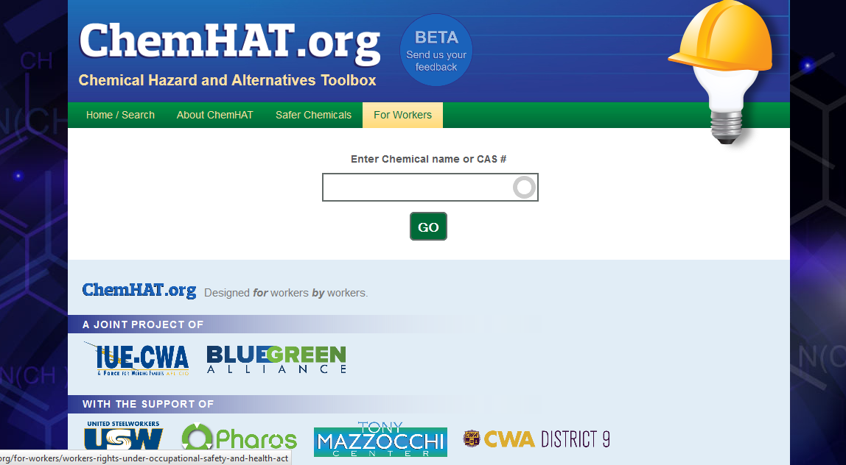

Slide 27
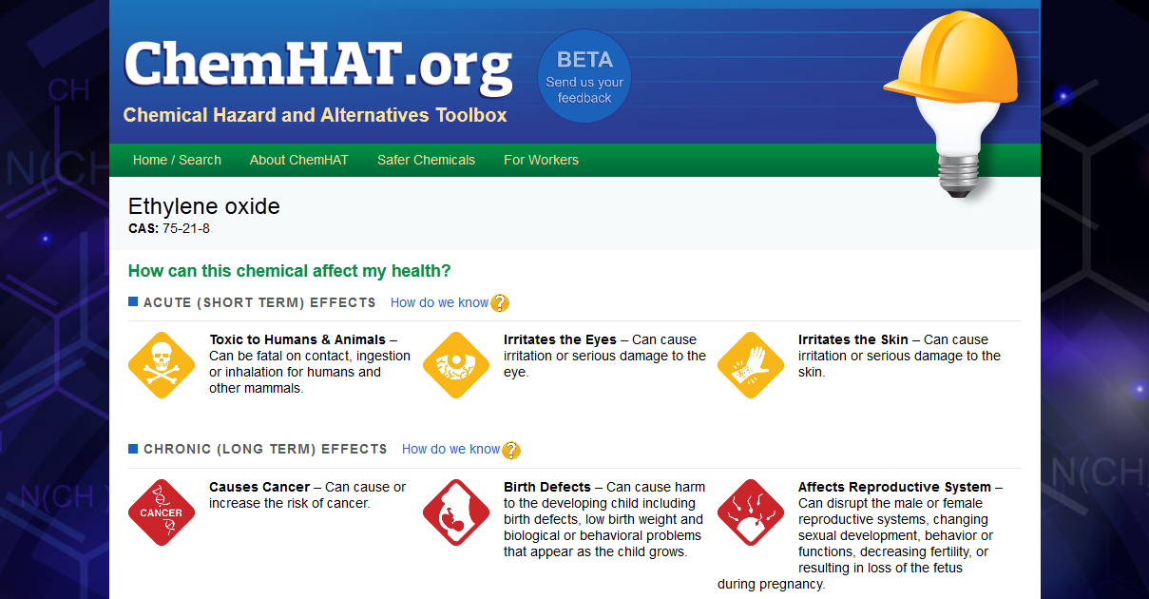
Notes:
Need new screenshot here with “How do we know?”

Slide 29
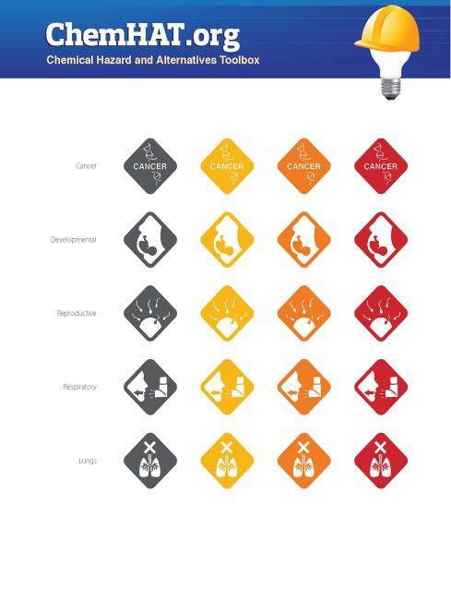
Notes:
Endpoint descriptors for each impact; color represents strength of impact, plus strength of data

Slide 30
ChemHAT vs. GHS Icons
Notes:
Wanted more specificity on the health endpoints

Slide 31
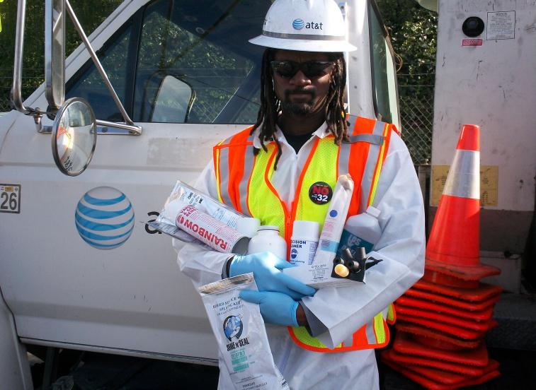

Slide 35
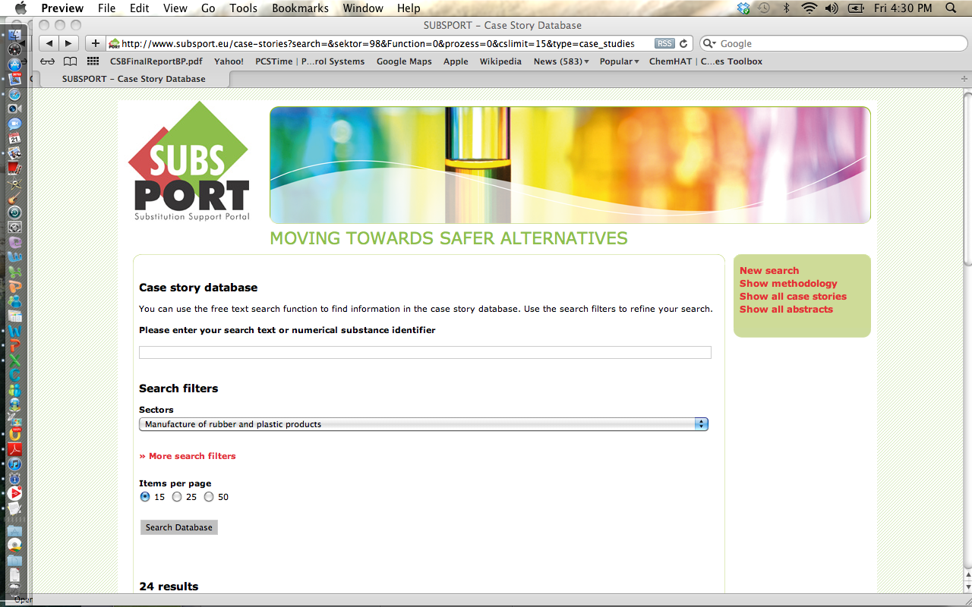

Slide 36
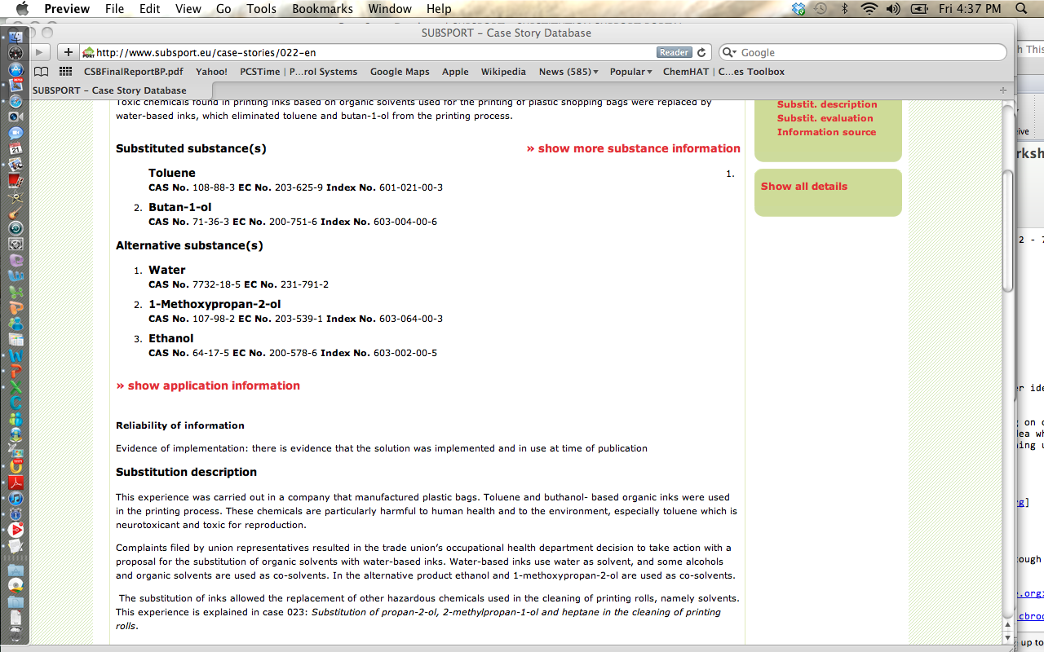

Slide 37
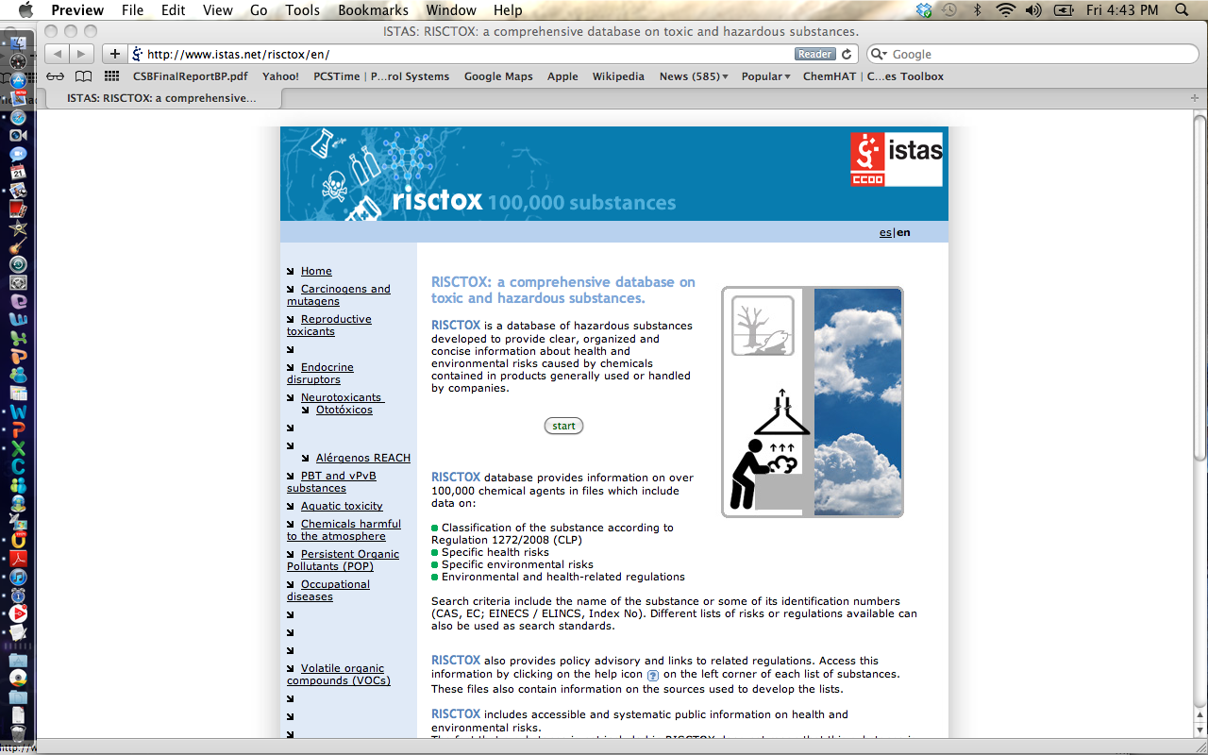

Slide 38
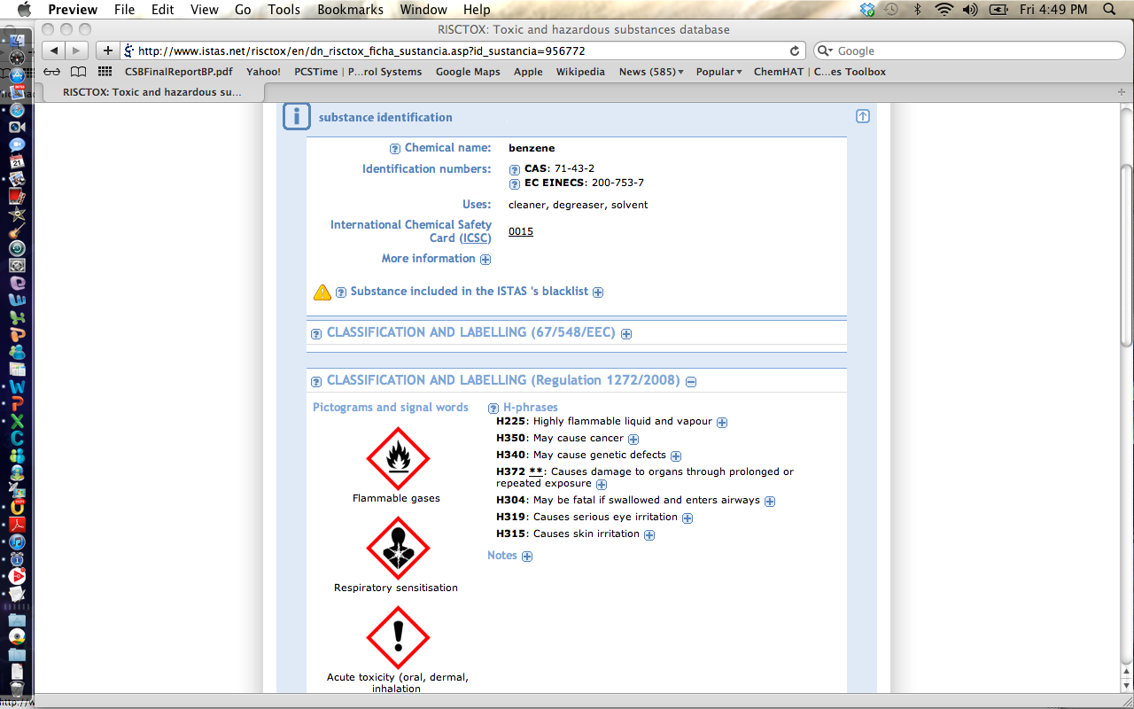

Slide 39
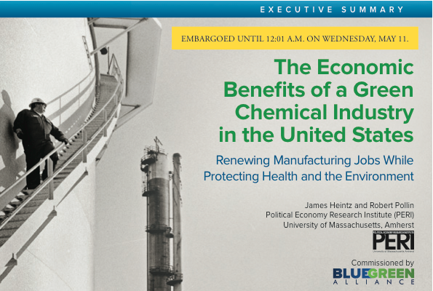
The Economic Benefits of a Green Chemical Industry: Renewing Manufacturing Jobs While Protecting Health and the Environment
=
Notes:
Thank you.

Slide 40
The U.S. Chemical Industry Today
The chemical industry is an important part of U.S. manufacturing, contributing $273 billion to GDP ($390 billion if we include the plastics sector).
But employment in the chemical industry has been declining sharply over the past few decades, despite the fact that the value of production has been growing 4% per year.

Slide 43
Greener Chemistry & Regulatory Reform Supports Competitiveness
Lowering handling, storage, and disposal costs
Ensuring access to global markets
Reducing waste by using inputs more efficiently
Moving away from fossil fuel based inputs
Meeting consumer demands for safer products
Protecting shareholder value

Slide 44
 | Decaffeinate coffee with benzene In 1970s benzene replaced with dichloromethane | Decaffeinate coffee with water or carbon dioxide
 | Manufacture IV bags and tubes using polyvinyl choride and DEHP | Switch production to lighter, stronger polypropylene plastic that do not contain chemicals of concern and does not need a moisture overwrap
 | Produce glass for electronics using arsenic to remove air bubbles | Maintain liquid glass at higher temperature for longer periods

Slide 45
Thank you.
Charlotte Brody, Associate Director for Health Initiatives
BlueGreen Alliance, cbrody@bluegreenalliance.org
www.bluegreenalliance.org www.chemhat.org

